Slide 1
Randomized Algorithms
Randomized Quick sort

Slide 2
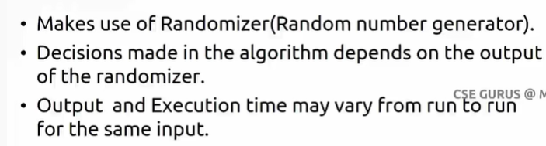
What is a Randomized Algorithm?
An algorithm that uses random numbers to decide what to do next anywhere in its logic is called a Randomized Algorithm.
For example, in Randomized Quick Sort, we use a random number to pick the next pivot (or we randomly shuffle the array)

Slide 3
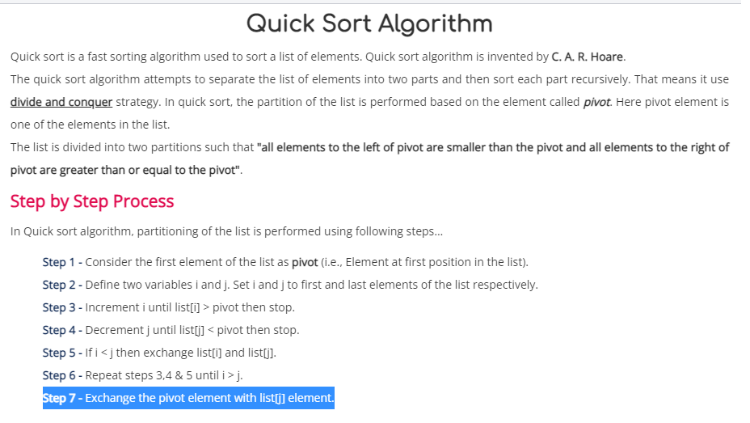

Slide 4
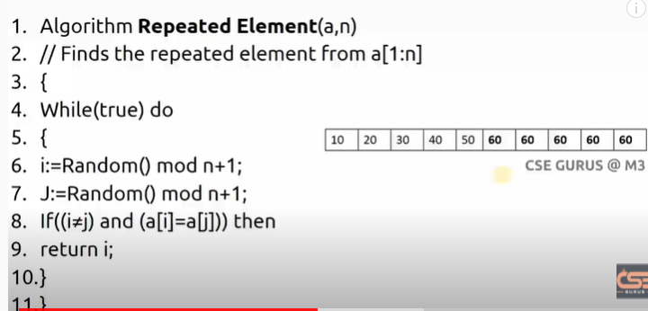

Slide 5
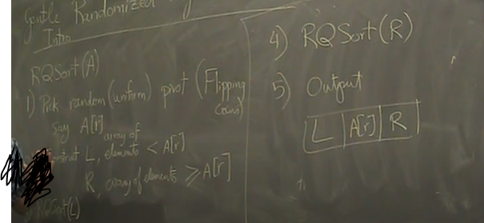
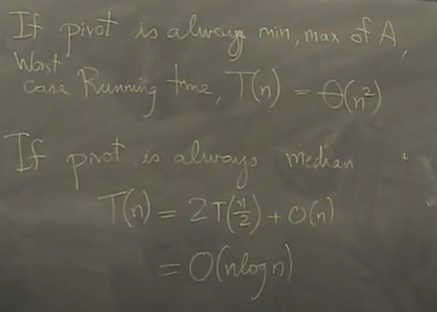

Slide 6
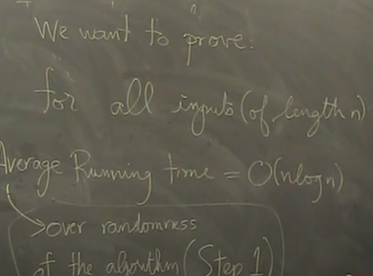

Slide 7
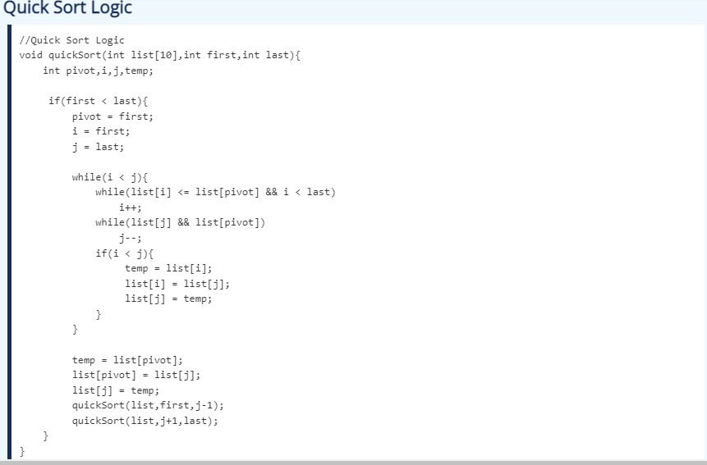

Slide 8
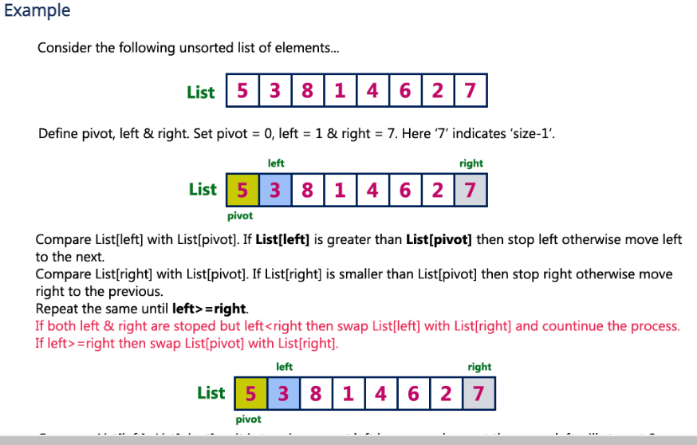

Slide 9
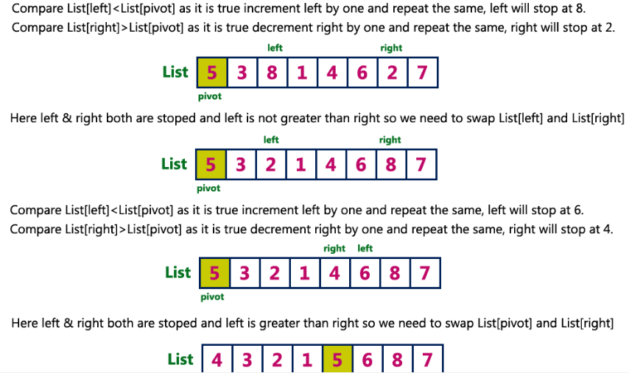

Slide 10
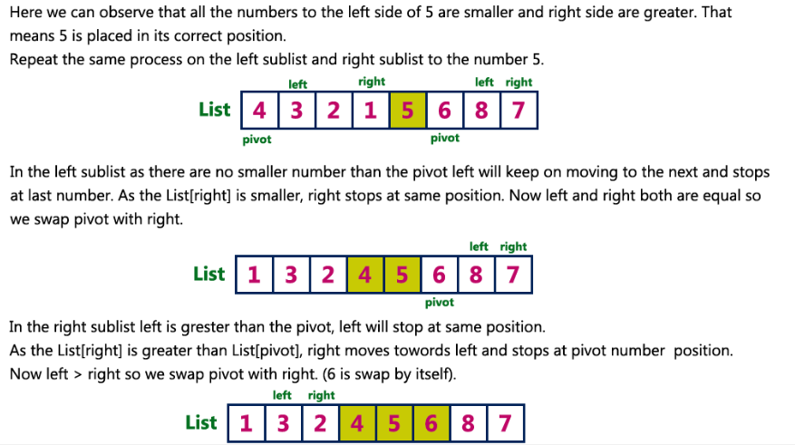

Slide 11
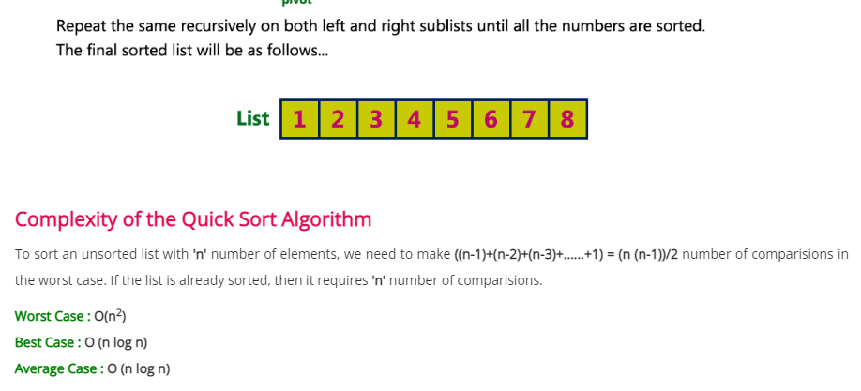

Slide 12
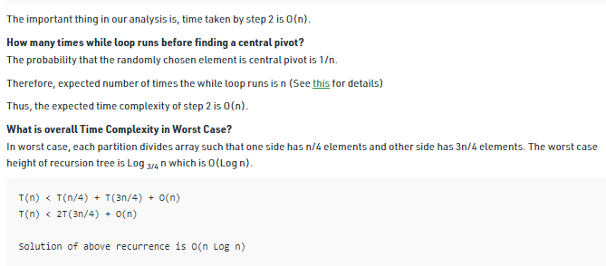
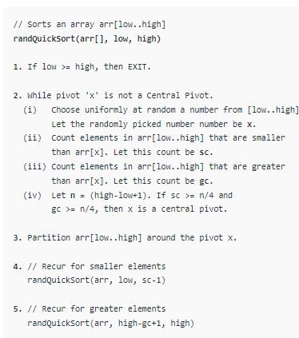
For example consider below a randomized version of QuickSort.
A Central Pivot is a pivot that divides the array in such a way that one side has at-least 1/4 elements.

Slide 13
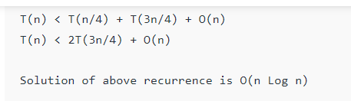
The important thing in our analysis is, time taken by step 2 is O(n).
How many times while loop runs before finding a central pivot? The probability that the randomly chosen element is central pivot is 1/n.
Therefore, expected number of times the while loop runs is n
Thus, the expected time complexity of step 2 is O(n).
What is overall Time Complexity in Worst Case? In worst case, each partition divides array such that one side has n/4 elements and other side has 3n/4 elements. The worst case height of recursion tree is Log _{3/4} n which is O(Log n).
Note that the above randomized algorithm is not the best way to implement randomized Quick Sort. The idea here is to simplify the analysis as it is simple to analyze. Typically, randomized Quick Sort is implemented by randomly picking a pivot (no loop). Or by shuffling array elements. Expected worst case time complexity of this algorithm is also O(n Log n), but analysis is complex,

